Slide 1
Electricity Demand Forecasting
for
California
Michael Boals

Slide 2
Value of Accurate Demand Forecasts
Supply Chain
Budgeting
Demand
Forecast
Cash Flow Planning
Labor
Management
Capacity/Capital
Planning
Notes:
Increase Supply Chain Efficiency
Improve Labor Management
Improve Capital Management
Insure Adequate Cash Flow
Improve Budgeting Accuracy

Slide 3
Goals
Evaluate Different Time Series Modeling Techniques
Accurately Predict Electricity Demand
Include Weather Temperature Forecast
Include State Population Forecast

Slide 4
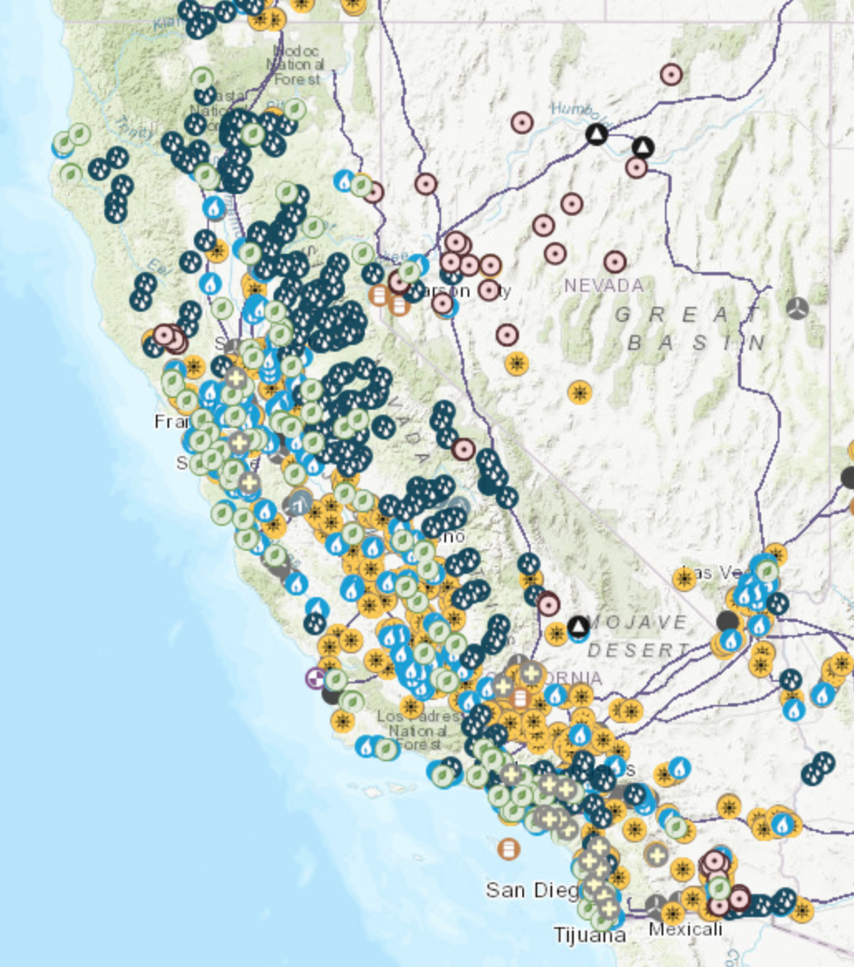
Data
California Demand from EIA
Weather from Dark Sky
Number of Households from Census Bureau – American Community Survey
Notes:
4 years of demand data at hourly intervals

Slide 5
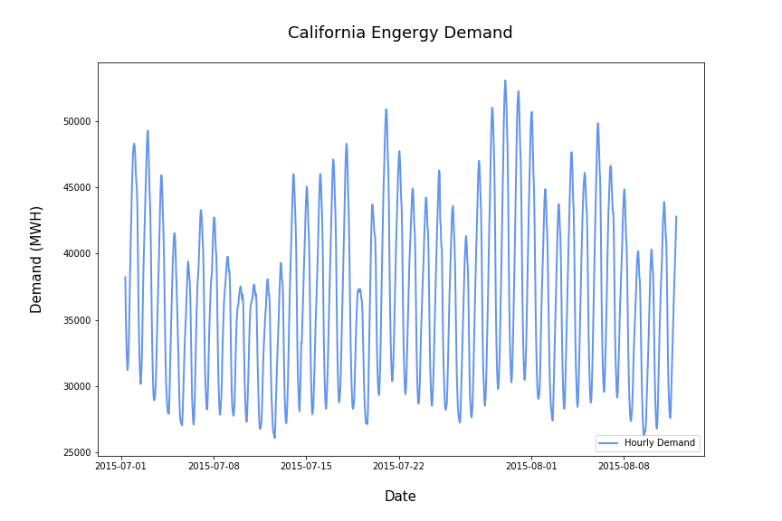
Notes:
Notice that there are daily, weekly and yearly seasonal components so we will need a model that can incorporate seasonality.

Slide 6
Model Options
Seasonal Autoregressive Integrating Moving Average (ARIMA/SARIMAX)
Autoregressive Conditional Heteroscedasticity (ARCH)
Vector Autoregression (VAR)
Long Short Term Memory (LSTM)
Prophet Forecasting Model
Notes:
There are many time series models available for forecasting. Some of the more popular models are listed here.

Slide 7
Model Options
Seasonal Autoregressive Integrating Moving Average (ARIMA/SARIMAX)
Autoregressive Conditional Heteroscedasticity (ARCH)
Vector Autoregression (VAR)
Long Short Term Memory (LSTM)
Prophet Forecasting Model
Notes:
Chose to evaluate SARIMAX and Prophet.
SARIMAX is a well known autoregressive model with moving average and differencing components. Adds a seasonal component but only one seasonal frequency.
Possible to incorporate additional seasons with Exogenous data
Prophet was developed in 2017 by two engineers at Facebook and also utilizes three components for its forecasting:
A trend component, a seasonal component and a holiday component.
The trend component is modeled with two parts: saturating growth model and piecewise linear model
The seasonal component uses Fourier Series at common business frequencies and the holiday component is modeled with linear regressors with activation windows around the holiday dates.

Slide 8
Methodology
Train and Test SARIMAX Models with Walk Forward Validation
Data Collection and Cleaning
Aggregate Data Over Three Sampling Periods
Evaluate Best Model Using Out of Sample Data and Simulated Weather Forecast
Train and Test FB Prophet Models with Walk Forward Validation
Notes:
Aggregated Data over day and week periods to try different inputs for models
Simulated Weather data by introducing normally distributed error

Slide 9
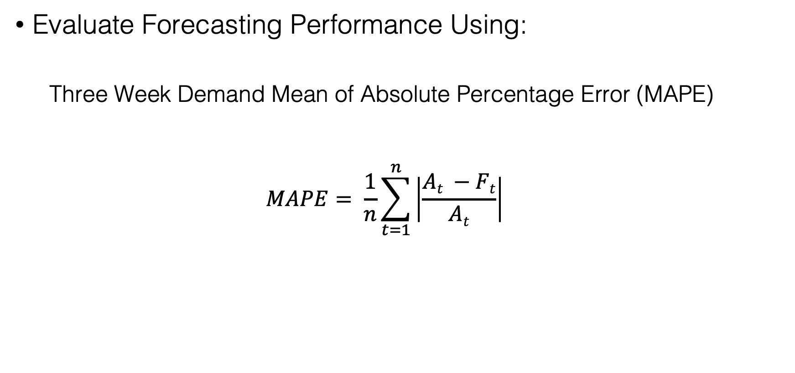
Performance Metrics
Evaluate Forecasting Performance Using:
Three Week Demand Mean of Absolute Percentage Error (MAPE)
$$MAPE= \frac{1}{n}\sum_{t=1}^{n}{\left|\frac{At −Ft}{At}\right|}$$
Notes:
Goal is to forecast two weeks ahead so I will use the three week mean as my metric for selecting a model.

Slide 10
Model Selection
 | 3 Week Forecast Walk Forward Validation MAPE Scores
 | Step 1 | Step 2 | Step 3
SARIMAX
Hourly | 5.6 | 7.5 | 7.5
Daily | 13.14 | 11.7 | 7.0
Weekly | 8.2 | 7.5 | 4.9
Prophet
Hourly | 14.5 | 11.4 | 6.3
Daily | 8.7 | 2.9 | 5.16
Weekly | 6.8 | 8.3 | 8.3

Slide 11
Model Selection
 | 3 Week Forecast Walk Forward Validation MAPE Scores
 | Step 1 | Step 2 | Step 3
SARIMAX
Hourly | 5.6 | 7.5 | 7.5
Daily | 13.14 | 11.7 | 7.0
Weekly | 8.2 | 7.5 | 4.9
Prophet
Hourly | 14.5 | 11.4 | 6.3
Daily | 8.7 | 2.9 | 5.16
Weekly | 6.8 | 8.3 | 8.3

Slide 12
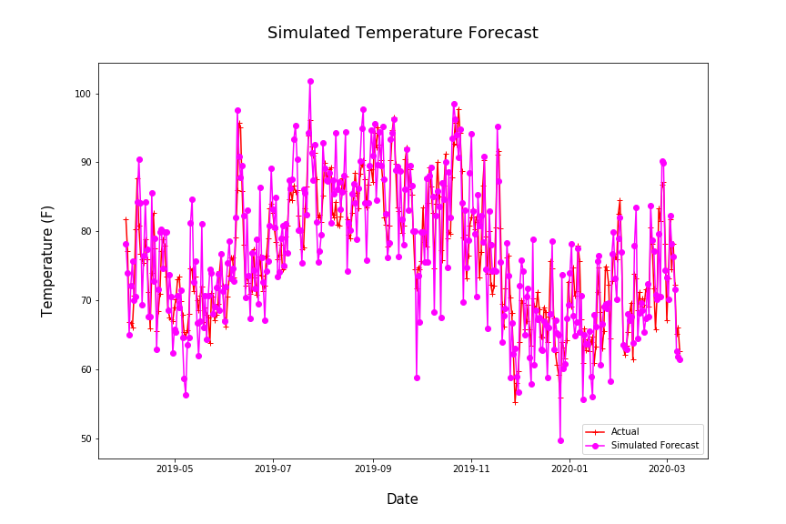
Exogenous Forecast Data
Need to simulate weather forecast
Add normal random offset mean of 5 F
Notes:
Longitudinal study on high temperature forecast accuracy

Slide 13
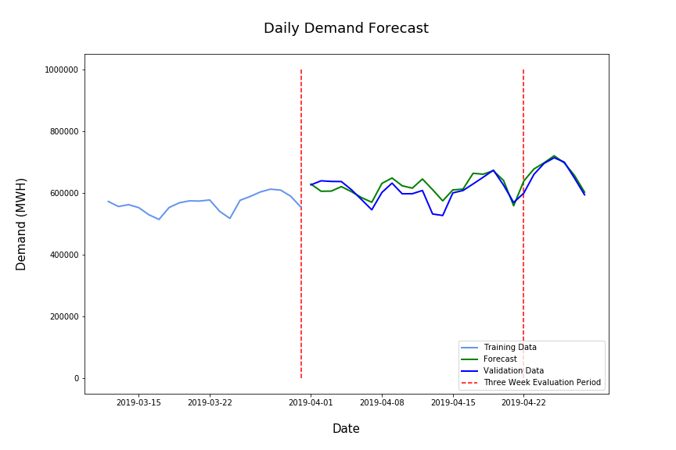
Final Prediction Performance
Notes:
Longitudinal study on high temperature forecast accuracy

Slide 14
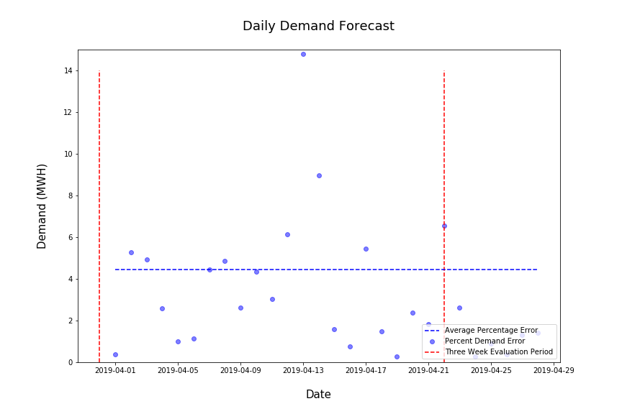
Final Prediction Error
Final MAPE = 3.5
Notes:
Longitudinal study on high temperature forecast accuracy

Slide 15
Take Away
Both SARIMAX and Prophet Provide Similar Short-Term Results
Prophet Performed Slightly Better
Prophet Trains Faster
Prophet Predictions Are More Accurate Further Into The Future

Slide 16
Take Away
Both SARIMAX and Prophet Provide Similar Short-Term Results
Prophet Performed Slightly Better
Prophet Trains Faster
Prophet Predictions Are More Accurate Further Into The Future
Thank You!

Slide 17
Appendix:

Slide 18

Model Equations
Seasonal Autoregressive Integrating Moving Average (ARIMA/SARIMAX)
SARIMAX Equation
$$yt= βxt+φ1yt−1+…+φpy t−p −θzt−1− …−θqzt−q+zt$$
x_{t} = exogenous regressors
z_{t} = error/noise
Prophet Forecasting Model
$yt=gt+st+ht+ εt$
g_{t} = trend function
s_{t} = seasonal periodic changes
h_{t} = holiday schedules
𝝴_{t} = idiosyncratic changes not included in the model
Notes:
Sarimax Model
Prophet Model
Trend model is two models: saturating growth model and piecewise linear model
Seasonality is forecast using low pass filtered Fourier series
Holidays are modeled using linear regressors with activation windows around the holiday dates.

Slide 19
Seasonal Decomposition

